Slide 1
BlackBox Testig

Slide 2
1. Introduction to Functional Testing
Functional testing is a black-box testing technique. This means the tester has no knowledge of the internal code or design of the system. The focus is solely on what the system is supposed to do, based on the requirements and specifications.
Key Characteristics:
Focus on functionality: Does the system meet the specified business and user requirements?
External perspective: It's performed from the user's point of view.
Driven by requirements: Test cases are derived directly from the functional requirements document.

Slide 3
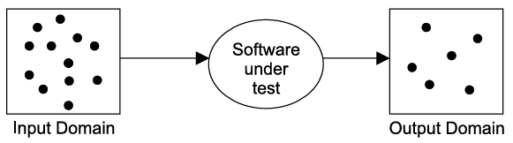
1. Introduction to Functional Testing
Functional testing techniques attempt to design those test cases which have a higher probability of making a software fail.
These techniques also attempt to test every possible functionality of the software.
Many activities are performed in real life with only black box knowledge like driving a car, using a cell phone, operating a computer
These techniques can be used at all levels of software testing like unit, integration, system and acceptance testing.

Slide 4
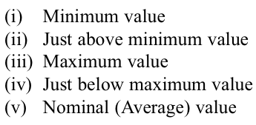

2.1 BOUNDARY VALUE ANALYSIS
Here, we concentrate on input values and design test cases with input values that are on or close to boundary values
Experience has shown that such test cases have a higher probability of detecting a fault in the software.

Slide 5
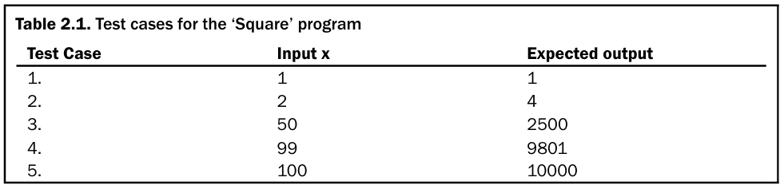
2.1 BOUNDARY VALUE ANALYSIS
The number of inputs selected by this technique is 4n + 1 where ‘n’ is the number of inputs.

Slide 6
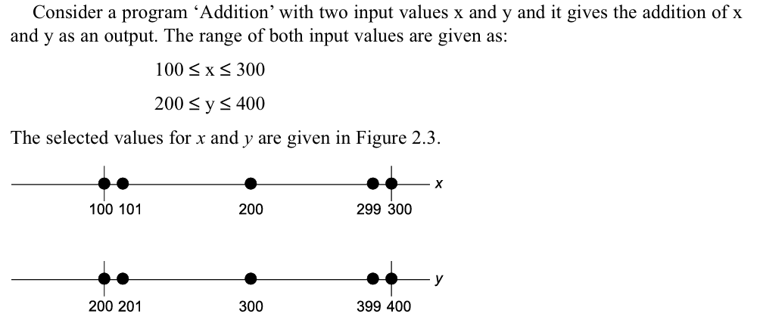
2.1 BOUNDARY VALUE ANALYSIS

Slide 7
2.1 BOUNDARY VALUE ANALYSIS
We also consider ‘single fault’ assumption theory of reliability which says that failures are rarely the result of the simultaneous occurrence of two (or more) faults.
Normally, one fault is responsible for one failure. With this theory in mind, we select one input value on
boundary (minimum)
just above boundary (minimum +)
just below boundary (maximum –)
on boundary (maximum)
nominal (average)

Slide 8
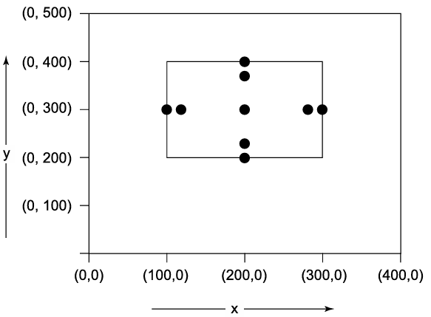
2.1 BOUNDARY VALUE ANALYSIS

Slide 9
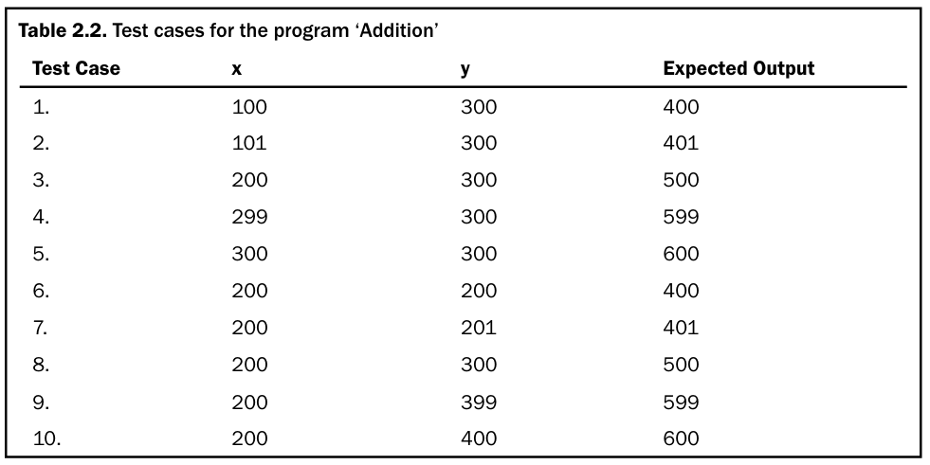
2.1 BOUNDARY VALUE ANALYSIS

Slide 10
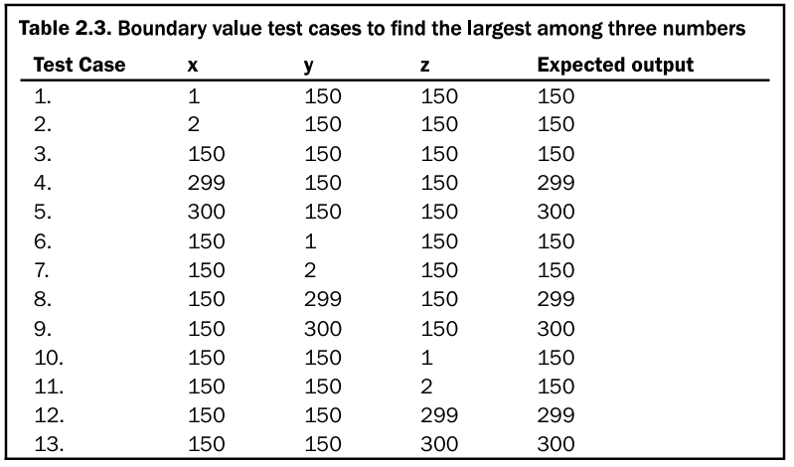
2.1 BOUNDARY VALUE ANALYSIS
Consider a program for the determination of the largest amongst three numbers. Its input is a triple of positive integers (say x,y and z) and values are from interval [1, 300].

Slide 11
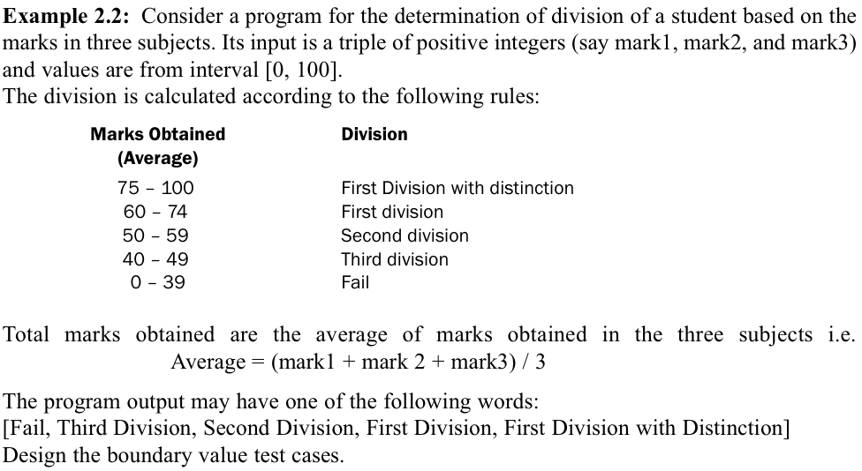
2.1 BOUNDARY VALUE ANALYSIS

Slide 12
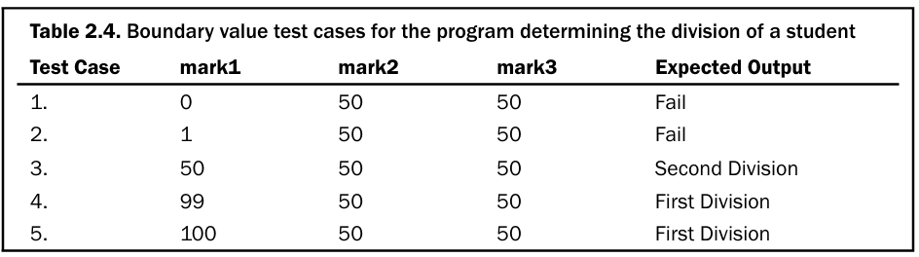
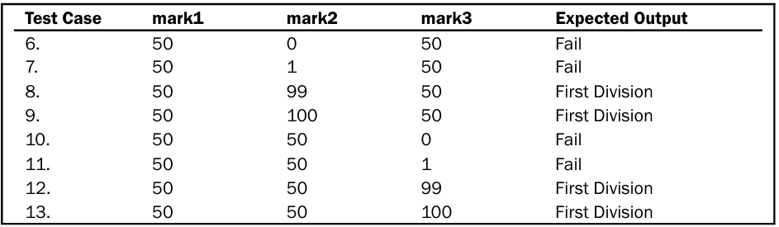
2.1 BOUNDARY VALUE ANALYSIS

Slide 13
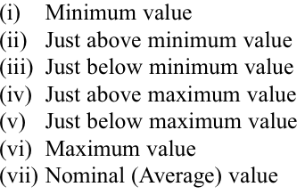
2.1.1 ROBUSTNESS TESTING
This is the extension of boundary value analysis.
Here, we also select invalid values and see the responses of the program.
Hence, two additional states are added i.e. just below minimum value (minimum value–) and just above maximum value (maximum value +).
Thus, the total test cases in robustness testing are 6n + 1, where ‘n’ is the number of input values.

Slide 14
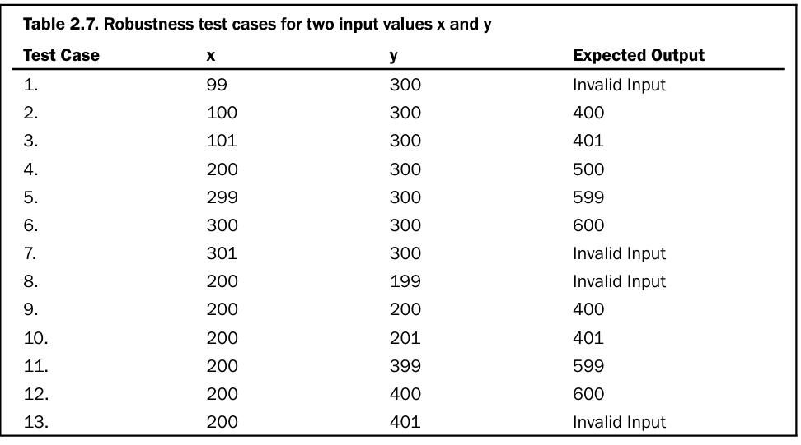
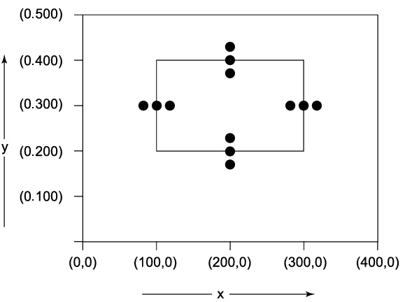
2.1.1 ROBUSTNESS TESTING

Slide 15


2.1.2 Worst-Case Testing
This is a special form of boundary value analysis where we don’t consider the ‘single fault’ assumption theory of reliability.
Now, failures are also due to occurrence of more than one fault simultaneously.
The restriction of one input value at any of the above mentioned values and other input values must be at nominal is not valid in worst-case testing.
This will increase the number of test cases from 4n + 1 test cases to 5^n test cases, where ‘n’ is the number of input values.

Slide 16
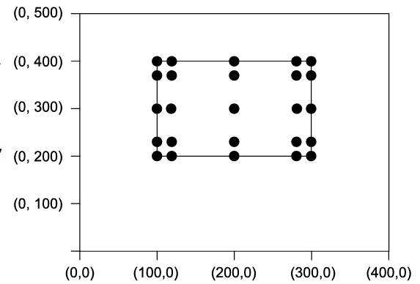
2.1.2 Worst-Case Testing
The program ‘Addition’ will have 5^2 = 25 test cases and these test cases are given in Table 2.8

Slide 17
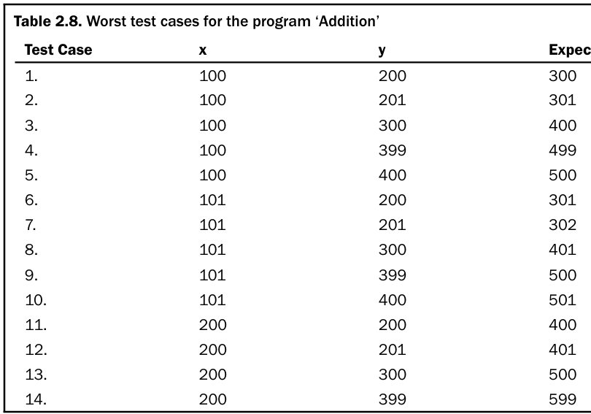
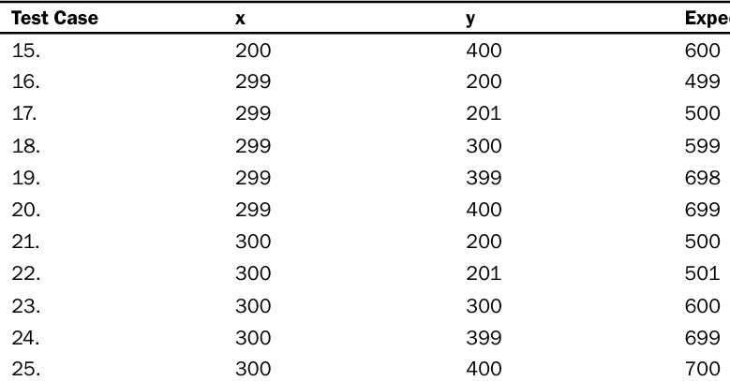
2.1.2 Worst-Case Testing
The program ‘Addition’ will have 5^2 = 25 test cases and these test cases are given in Table 2.8

Slide 18
2.1.3 Robust Worst-Case Testing
In robustness testing, we add two more states i.e. just below minimum value (minimum value–) and just above maximum value (maximum value+). We also give invalid inputs and observe the behaviour of the program.
There are seven states (minimum -, minimum, minimum +, nominal, maximum –, maximum, maximum +)
total of 7^n test cases will be generated

Slide 19
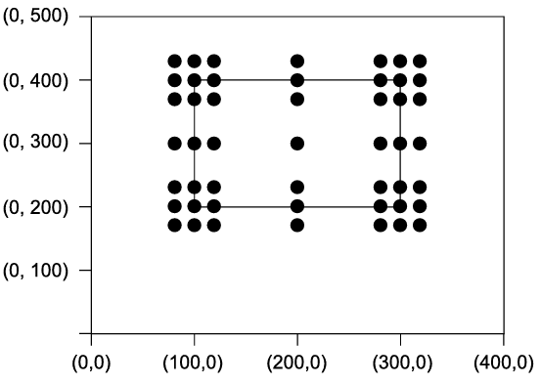
2.1.3 Robust Worst-Case Testing
The inputs for the program ‘Addition’ are graphically shown in Figure 2.8. The program ‘Addition’ will have 7^2 = 49 test cases and these test cases are shown in Table 2.9

Slide 20
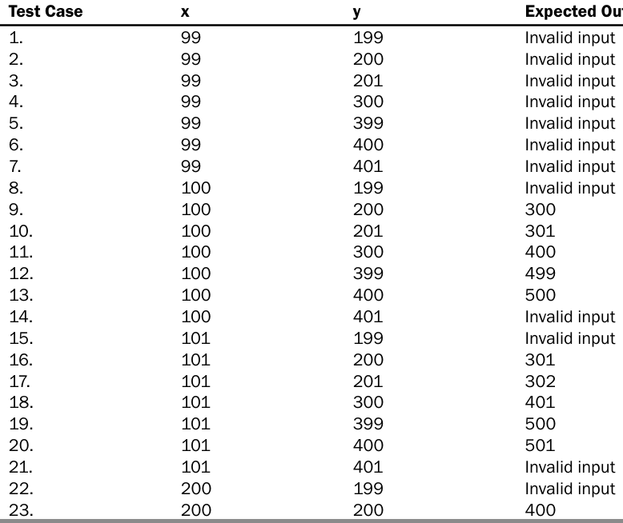
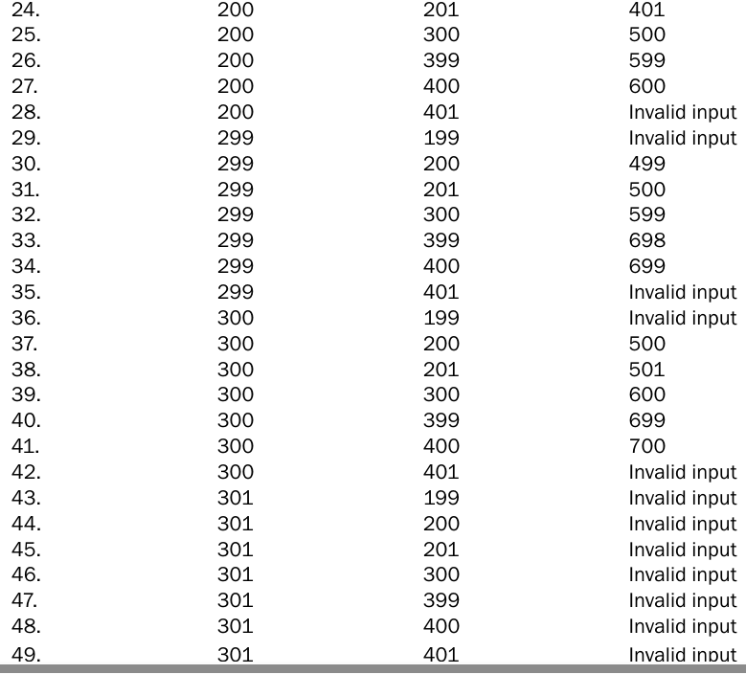
2.1.3 Robust Worst-Case Testing

Slide 21
2.1.4 Applicability
Boundary value analysis is a simple technique and may prove to be effective when used correctly.
Here, input values should be independent which restricts its applicability in many programs.
This technique does not make sense for Boolean variables where input values are TRUE and FALSE only, and no choice is available for nominal values, just above boundary values, just below boundary values, etc.
This technique can significantly reduce the number of test cases and is suited to programs in which input values are within ranges or within sets.
This is equally applicable at the unit, integration, system and acceptance test levels. All we want is input values where boundaries can be identified from the requirements.

Slide 22
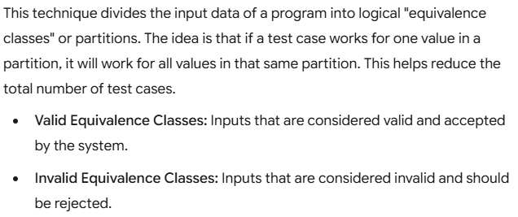
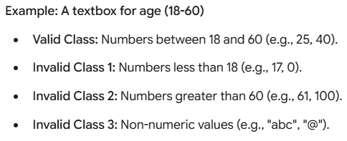
2. Equivalence Partitioning

Slide 23

2.2.1 Creation of Equivalence Classes
The entire input domain can be divided into at least two equivalence classes: one containing all valid inputs and the other containing all invalid inputs.
Each equivalence class can further be sub-divided into equivalence classes on which the program is required to behave differently.
The input domain equivalence classes for the program ‘Square’ which takes ‘x’ as an input (range 1-100) and prints the square of ‘x’ (seen in Figure 2.2) are given as:

Slide 24
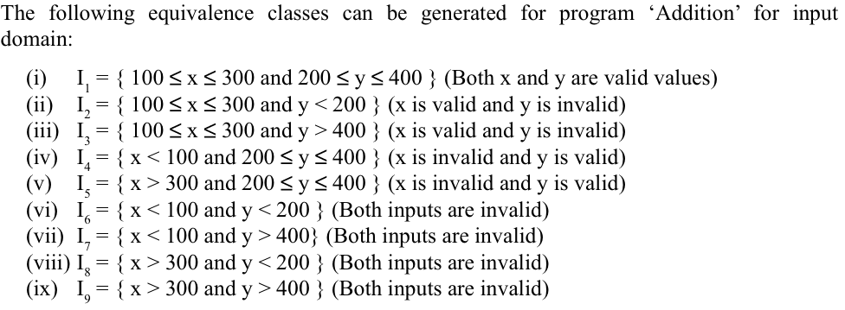
2.2.1 Creation of Equivalence Classes

Slide 25
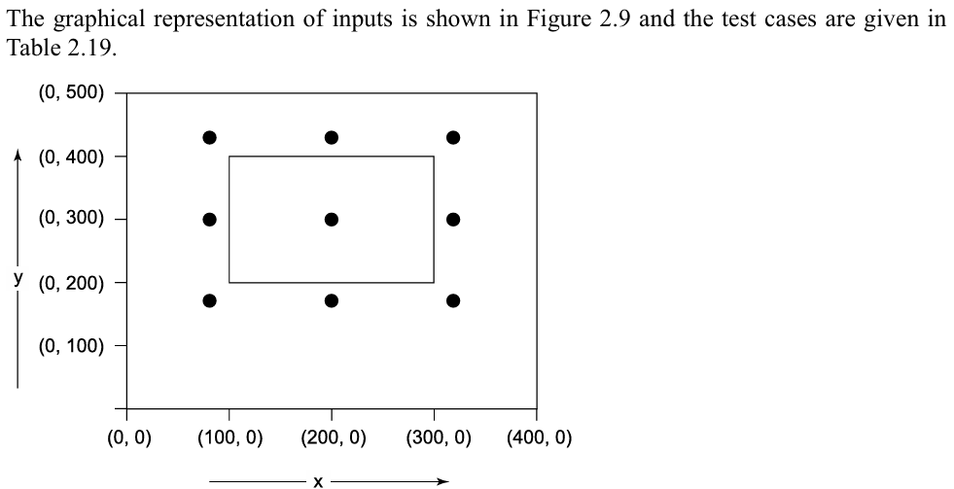
2.2.1 Creation of Equivalence Classes

Slide 26
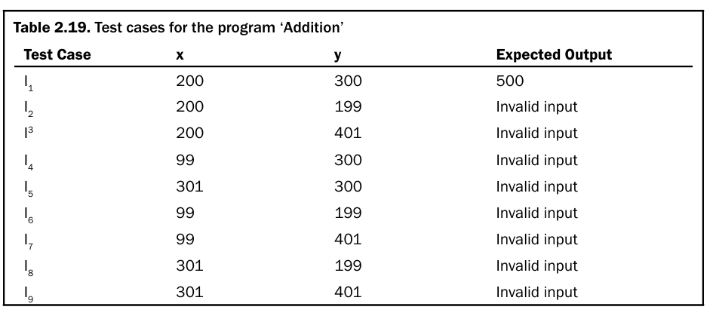
2.2.1 Creation of Equivalence Classes

Slide 27

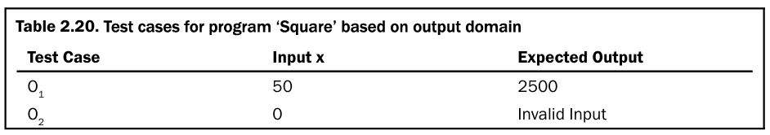

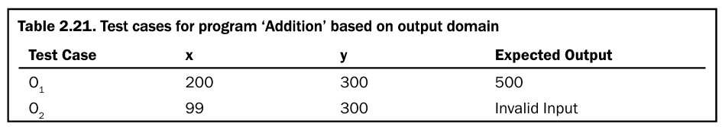
2.2.1 Creation of Equivalence Classes
From output domain
Notes:
In the above two examples, valid input domain has only one equivalence class.
We may design more numbers of equivalence classes based on the type of problem and nature of inputs and outputs.
Here, the most important task is the creation of equivalence classes which require domain knowledge and experience of testing.
This technique reduces the number of test cases that should be designed and executed.

Slide 28
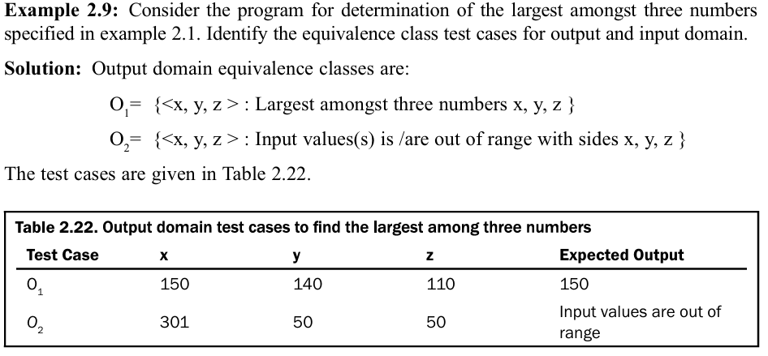
2.2.2 Applicability
It is applicable at unit, integration, system and acceptance test levels.

Slide 29
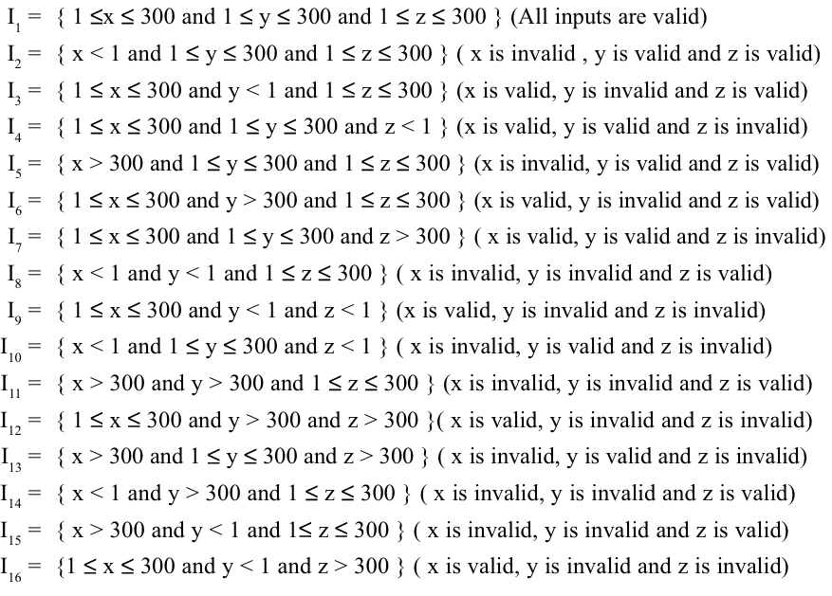
2.2.2 Applicability

Slide 30
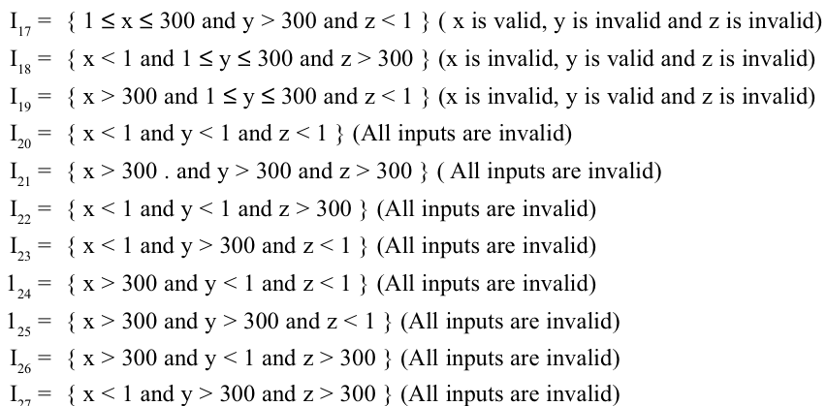
2.2.2 Applicability

Slide 31
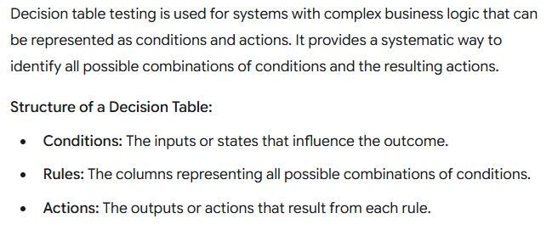
2.3 DECISION TABLE BASED TESTING

Slide 32
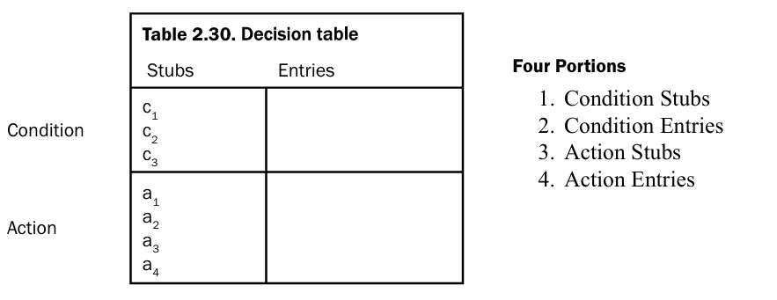
2.3 DECISION TABLE BASED TESTING

Slide 33
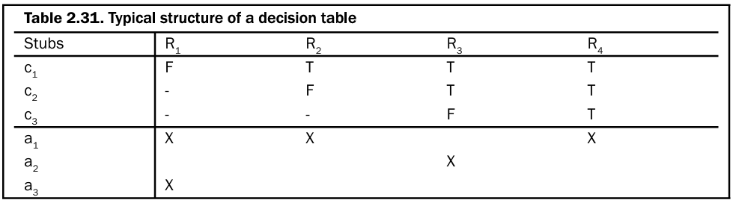
2.3.2Limited Entry and Extended Entry Decision Tables
The decision tables which use only binary conditions are known as limited entry decision tables.
The decision tables which use multiple conditions where a condition may have many possibilities instead of only ‘true’ and ‘false’ are known as extended entry decision tables

Slide 34
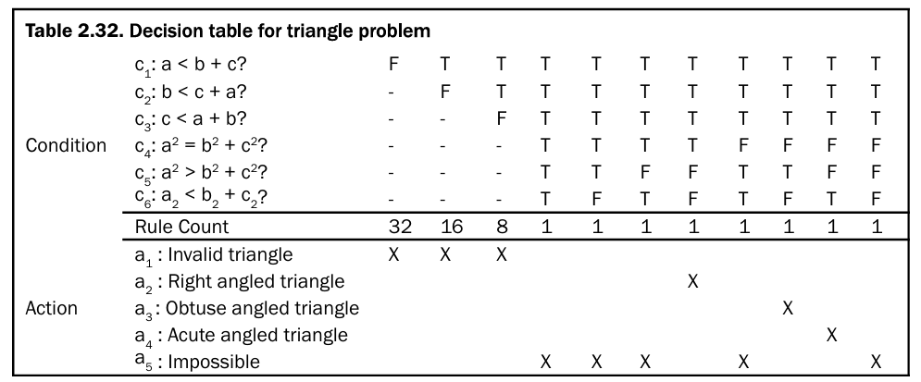
2.3.3 ‘DoNot Care’ Conditions and Rule Count
Notes:
If we do not do so and represent all true and false entries of every condition, the number of columns in the decision table will unnecessarily increase.
Hence, the actual number of columns in any decision table is the sum of the rule counts of every column shown in the decision table.
The triangle classification decision table has 11 columns as shown in Table 2.32. However the actual columns are a sum of rule counts and are equal to 64.

Slide 35
2.3.3 ‘DoNot Care’ Conditions and Rule Count Impossible Conditions
Notes:
Decision tables are very popular for the generation of test cases. Sometimes, we may have to make a few attempts to reach the final solution. Some impossible conditions are also generated due to combinations of various inputs and an ‘impossible’ action is incorporated in the ‘action stub’ to show such a condition. We may have to redesign the input classes to reduce the impossible actions. Redundancy and inconsistency may create problems but may be reduced by proper designing of input classes depending upon the functionality of a program.

Slide 36
2.3.5 Applicability
Decision tables are popular in circumstances where an output is dependent on many conditions and a large number of decisions are required to be taken.
They may also incorporate complex business rules and use them to design test cases.
Every column of the decision table generates a test case.
As the size of the program increases, handling of decision tables becomes difficult and cumbersome.
In practice, they can be applied easily at unit level only. System testing and integration testing may not find its effective applications.

Slide 37
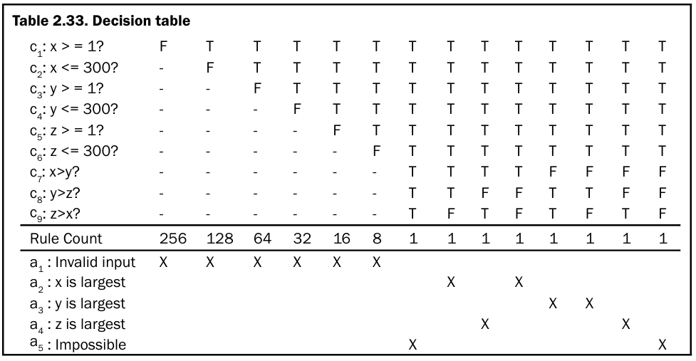
2.3.5 Applicability

Slide 38
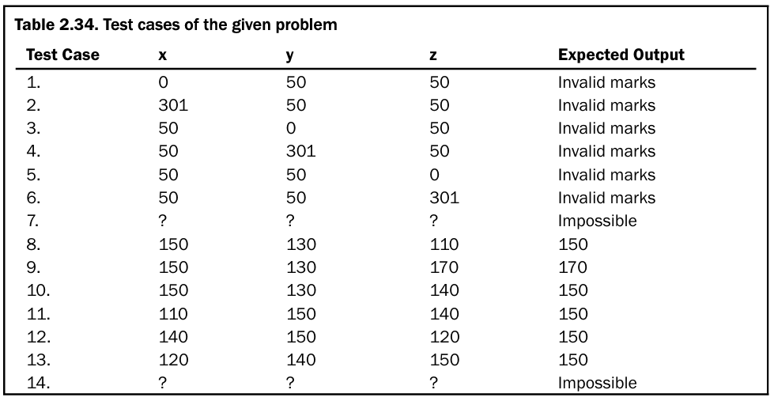
2.3.5 Applicability

Slide 39
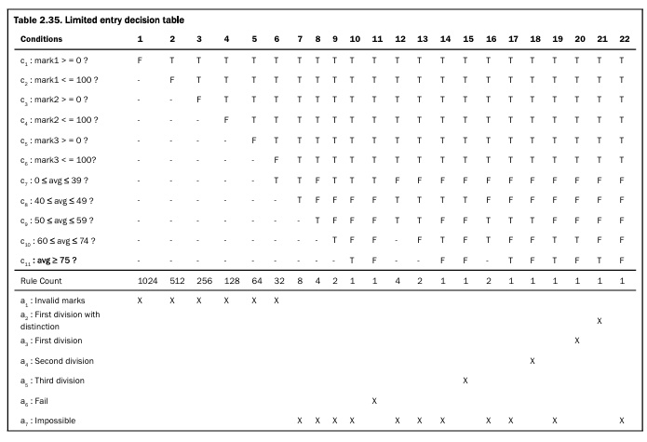
2.3.5 Applicability

Slide 40
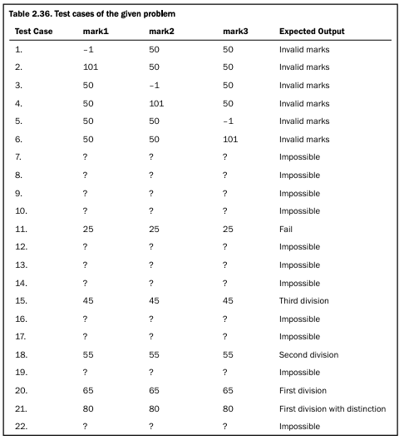
2.3.5 Applicability

Slide 41
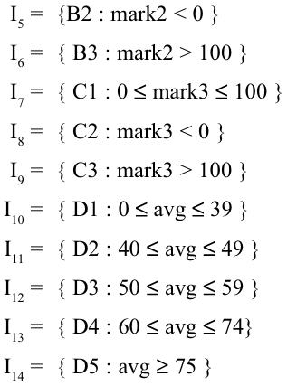
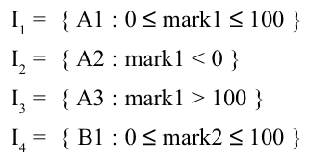

2.3.5 Applicability

Slide 42
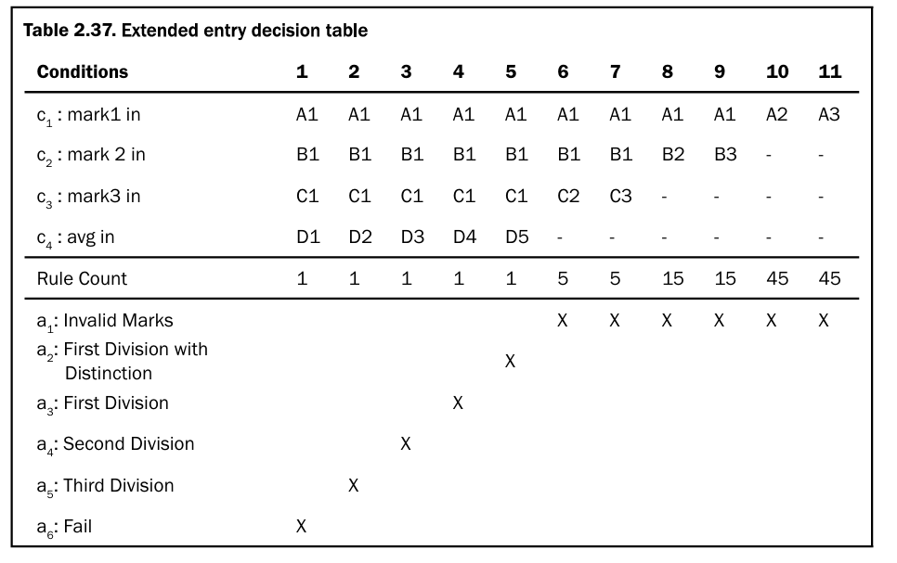
2.3.5 Applicability

Slide 43
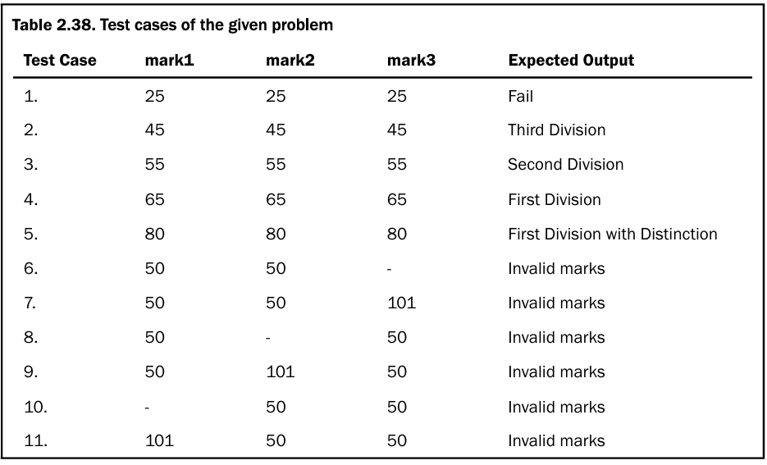
2.3.5 Applicability

Slide 44
Decision table optimization
1. Rule Consolidation (The "Don't Care" Method)
The most common optimization is merging rules that result in the same action regardless of a specific condition’s value.
We represent these with a dash - or an "X," signifying a "Don't Care" entry.
How it works: If Rule 1 and Rule 2 result in "Action A," and the only difference between them is that Condition 3 is "True" in one and "False" in the other, Condition 3 is irrelevant for that specific outcome.
Result: You can merge two columns into one, effectively halving the complexity of that specific logic branch.
2. Identify Mutually Exclusive ConditionsIn many systems, certain conditions cannot physically or logically occur at the same time.
Identifying these allows you to prune "impossible" columns immediately.
Example: If you have conditions for Is_Under_18 and Is_Senior_Citizen, they cannot both be "True."Optimization:
Remove all columns where both are "True." This drastically reduces the total count before you even start writing test cases.

Slide 45
Decision table optimization example
Let’s use an Auto Insurance Premium logic. It’s a classic example because it involves risk factors that often overlap, making it a prime candidate for "collapsing."
The Requirements
Age < 25: Young drivers are higher risk.
Accident History: Any accident in the last 3 years.
High-Performance Car: Sports cars increase the premium.
Business Rules:
If the driver is young AND has an accident history, Reject the policy (regardless of car type).
If the driver is 25+ with no accidents and a standard car, Standard Rate.
Any other combination of "High Risk" factors (Young, Accident, or Sports Car) results in a Surcharge.

Slide 46
Decision table optimization example
Let’s use an Auto Insurance Premium logic. It’s a classic example because it involves risk factors that often overlap, making it a prime candidate for "collapsing."
The Requirements
Age < 25: Young drivers are higher risk.
Accident History: Any accident in the last 3 years.
High-Performance Car: Sports cars increase the premium.
Business Rules:
If the driver is young AND has an accident history, Reject the policy (regardless of car type).
If the driver is 25+ with no accidents and a standard car, Standard Rate.
Any other combination of "High Risk" factors (Young, Accident, or Sports Car) results in a Surcharge.

Slide 47
Decision table optimization example
Conditions | R1 | R2 | R3 | R4 | R5 | R6 | R7 | R8
C1: Age < 25? | Y | Y | Y | Y | N | N | N | N
C2: Accident History? | Y | Y | N | N | Y | Y | N | N
C3: Sports Car? | Y | N | Y | N | Y | N | Y | N
Actions
A1: Standard Rate |  |  |  |  |  |  |  | X
A2: Surcharge |  |  | X | X | X | X | X
A3: Reject | X | X

Slide 48
Decision table optimization example
To optimize, we look for rules that have the same outcome where one condition doesn't actually change that outcome.
Look at R1 and R2: Both result in "Reject." The only difference is the Sports Car (C3). This means if you are young and have accidents, we don't care what car you drive.
Look at R5 and R6: Both result in "Surcharge." The only difference is the Sports Car (C3). If you have accidents and are over 25, you get a surcharge regardless of the car.
Look at R3 and R4: Both result in "Surcharge." However, we have to be careful here—if we collapse these, we might lose the distinction of the car type. Wait, actually, if you are young and have no accidents, you get a surcharge regardless of the car (one for being young, or one for the car).

Slide 49
Decision table optimization example
Conditions | Rule A | Rule B | Rule C | Rule D | Rule E
C1: Age < 25? | Y | Y | N | N | N
C2: Accident History? | Y | N | Y | N | N
C3: Sports Car? | — | — | — | Y | N
Actions
A1: Standard Rate |  |  |  |  | X
A2: Surcharge |  | X | X | X
A3: Reject | X
Notes:
Gemini said
Let’s use an Auto Insurance Premium logic. It’s a classic example because it involves risk factors that often overlap, making it a prime candidate for "collapsing."
The Requirements
Age < 25: Young drivers are higher risk.
Accident History: Any accident in the last 3 years.
High-Performance Car: Sports cars increase the premium.
Business Rules:
If the driver is young AND has an accident history, Reject the policy (regardless of car type).
If the driver is 25+ with no accidents and a standard car, Standard Rate.
Any other combination of "High Risk" factors (Young, Accident, or Sports Car) results in a Surcharge.
Step 1: The Initial (Unoptimized) Table
With 3 binary conditions, we have 23=8 possible rules.
ConditionsR1R2R3R4R5R6R7R8C1: Age < 25?YYYYNNNNC2: Accident History?YYNNYYNNC3: Sports Car?YNYNYNYNActionsA1: Standard RateXA2: SurchargeXXXXXA3: RejectXX
Step 2: Identify the "Collapsing" Opportunities
To optimize, we look for rules that have the same outcome where one condition doesn't actually change that outcome.
Look at R1 and R2: Both result in "Reject." The only difference is the Sports Car (C3). This means if you are young and have accidents, we don't care what car you drive.
Look at R5 and R6: Both result in "Surcharge." The only difference is the Sports Car (C3). If you have accidents and are over 25, you get a surcharge regardless of the car.
Look at R3 and R4: Both result in "Surcharge." However, we have to be careful here—if we collapse these, we might lose the distinction of the car type. Wait, actually, if you are young and have no accidents, you get a surcharge regardless of the car (one for being young, or one for the car).
Step 3: The Optimized Table
By using the "Don't Care" (—) symbol, we can reduce 8 rules down to 5.
ConditionsRule ARule BRule CRule DRule EC1: Age < 25?YYNNNC2: Accident History?YNYNNC3: Sports Car?———YNActionsA1: Standard RateXA2: SurchargeXXXA3: RejectX
What happened?
Rule A: Merged R1 & R2. If C1=Y and C2=Y, C3 is irrelevant.
Rule B: Merged R3 & R4. If you're young but have no accidents, you get a surcharge (high risk) no matter the car.
Rule C: Merged R5 & R6. If you're 25+ but have accidents, surcharge applies regardless of the car.
Rule D: (R7) High-performance car for a "safe" older driver.
Rule E: (R8) The only path to a standard rate.

Slide 50
CAUSE-EFFECT GRAPHING TECHNIQUE
This technique is a popular technique for small programs and considers the combinations of various inputs which were not available in earlier discussed techniques like boundary value analysis and equivalence class testing.
Such techniques do not allow combinations of inputs and consider all inputs as independent inputs.
Two new terms are used here and these are causes and effects, which are nothing but inputs and outputs respectively.

Slide 51
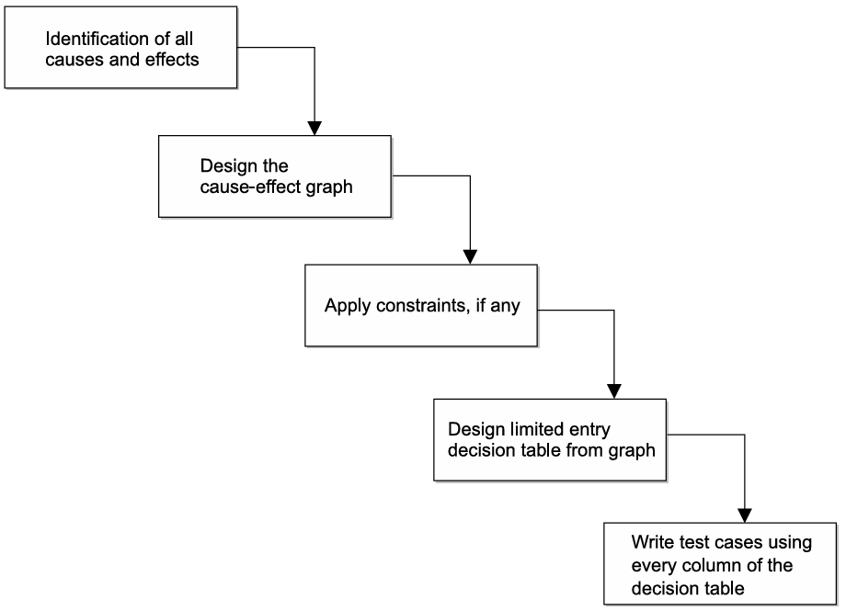
CAUSE-EFFECT GRAPHING TECHNIQUE

Slide 52
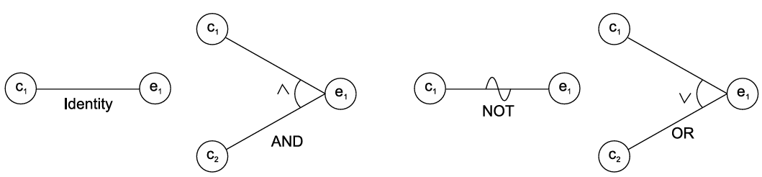
CAUSE-EFFECT GRAPHING TECHNIQUE
Identification of Causes and Effects
The SRS document is used for the identification of causes and effects.
Design of Cause-Effect Graph
The relationship amongst causes and effects are established using cause-effect graph. The basic notations of the graph

Slide 53
CAUSE-EFFECT GRAPHING TECHNIQUE
Use of Constraints in Cause-Effect Graph
Exclusive The Exclusive (E) constraint states that at most one of c1 or c2 can be 1 (c1 or c2 cannot be 1 simultaneously). However, both c1 and c2 can be 0 simultaneously.
Inclusive The Inclusive (I) constraints states that at least one of c1 or c2 must always be 1. Hence, both cannot be 0 simultaneously. However, both can be 1.
One and Only One The one and only one (O) constraint states that one and only one of c1 and c2 must be 1
Requires The requires (R) constraint states that for c1 to be 1, c2 must be 1; it is impossible for c1 to be 1 if c2 is 0.
Mask This constraint is applicable at the effect side of the cause-effect graph. This states that if effect e1 is 1, effect e2 is forced to be 0.
Notes:
There may be a number of causes (inputs) in any program.
We may like to explore the relationships amongst the causes and this process may lead to some impossible combinations of causes.
Such impossible combinations or situations are represented by constraint symbols which are given

Slide 54
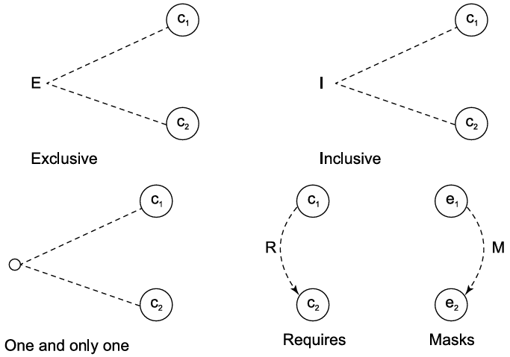
CAUSE-EFFECT GRAPHING TECHNIQUE

Slide 55
CAUSE-EFFECT GRAPHING TECHNIQUE
Consider the example of keeping the record of marital status and number of children of a citizen.
The value of marital status must be ‘U’ or ‘M’.
The value of the number of children must be digit or null in case a citizen is unmarried.
If the information entered by the user is correct then an update is made.
If the value of marital status of the citizen is incorrect, then the error message 1 is issued.
Similarly, if the value of number of children is incorrect, then the error message 2 is issued.

Slide 56
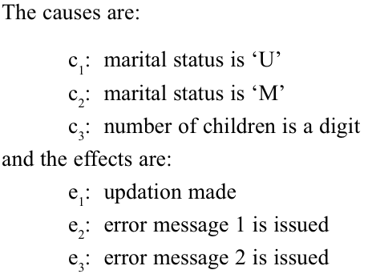
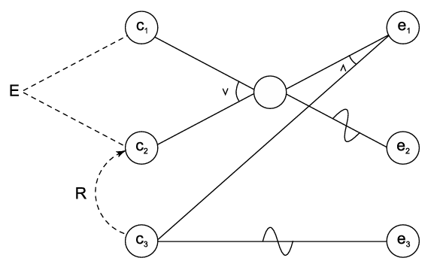
CAUSE-EFFECT GRAPHING TECHNIQUE
Consider the example of keeping the record of marital status and number of children of a citizen.

Slide 57
CAUSE-EFFECT GRAPHING TECHNIQUE
A tourist of age greater than 21 years and having a clean driving record is supplied a rental car. A premium amount is also charged if the tourist is on business, otherwise it is not charged.
If the tourist is less than 21 year old, or does not have a clean driving record, the system will display the following message: “Car cannot be supplied”

Slide 58
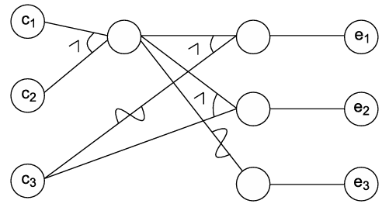
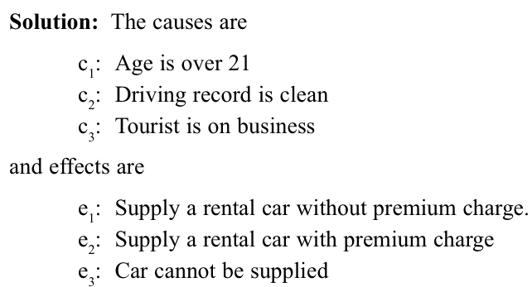
CAUSE-EFFECT GRAPHING TECHNIQUE

Slide 59
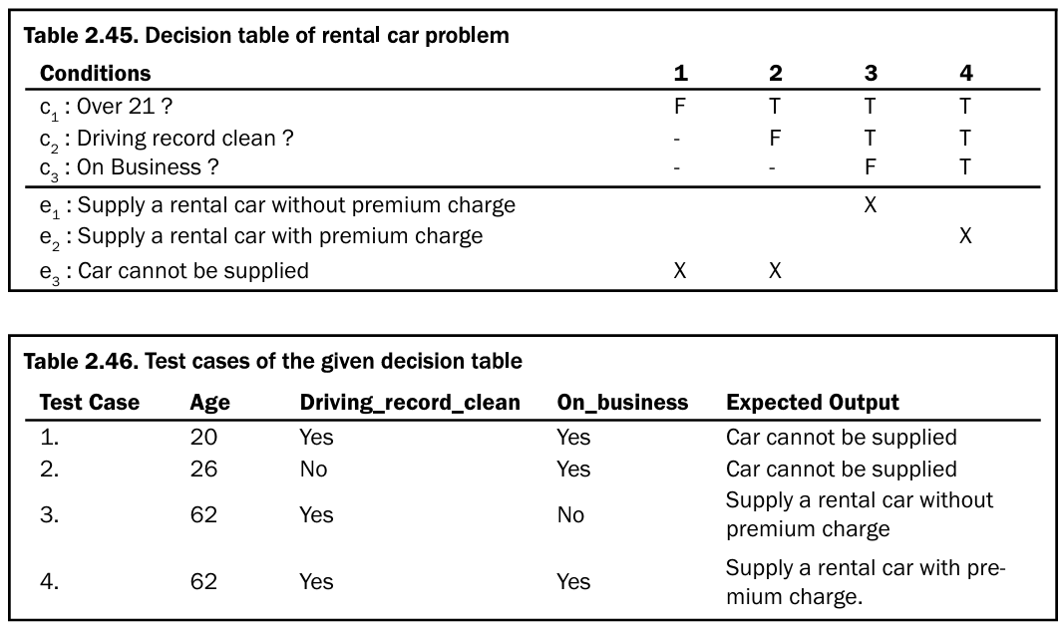
CAUSE-EFFECT GRAPHING TECHNIQUE

Slide 60
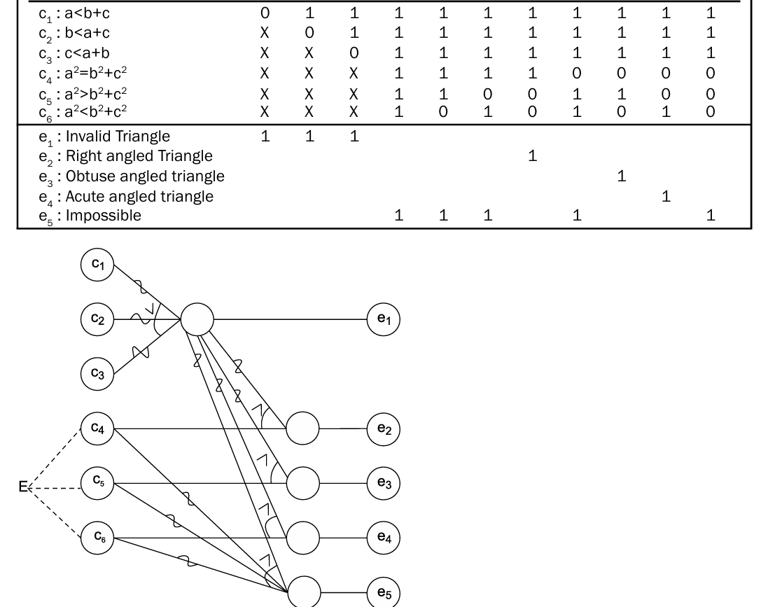
CAUSE-EFFECT GRAPHING TECHNIQUE

Slide 61
CAUSE-EFFECT GRAPHING TECHNIQUE VS DECISION BASED TESTING
Representation: Tabular vs. Graphical
The Process Flow (The "Pre-requisite" Relationship)
Cause-Effect Graphing is often a pre-step. You create the graph to visualize and analyze the logical dependencies between inputs.
The Decision Table is the result of the graph. Once the graph is drawn, you convert it into a decision table to derive the actual test cases.
Handling Constraints (E, I, O, R)
Cause-Effect Graphing: It has explicit notation for constraints between causes and effects.
Logic Discovery
Decision Tables: These are best when the requirements are already clear and the combinations are straightforward
Cause-Effect Graphing: This is a discovery tool. It helps the tester find contradictions or ambiguities in the requirements.
Notes:
Decision Table Testing: While you can "optimize" a table by removing impossible columns (as we discussed in our previous session), the table itself doesn't have a built-in notation to visualize these constraints. The table just shows the final valid combinations.

